Slide 1
ACTS 3.0
Update: 2023/Dec/12

Slide 2
Topics
What is ACTS 3.0
PyTest
PyTest Script Structure
Allure Report
Syntax Define
ACTS 3.0 Instructions
Runner GUI
Variable FIles
Allure Report Process
Script Process
API Reference
API Structure
Source Code Documentation
Setup Visual Studio Code

Slide 3
What is ACTS 3.0?

Slide 4


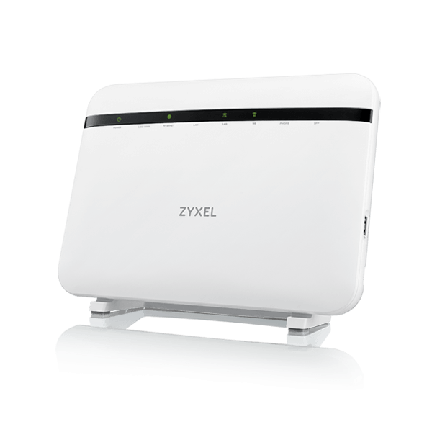

ACTS 2.1 test site
Lab or office network (Internet)
ACTS Site
Build by
vmware vSphere
ACTS
(WIN7)
NAT
(Ubuntu)
TCL/TK
LAN1
WKS
(Ubuntu)
LAN1
LAN2
WKS
(Ubuntu)
LAN2
AXESS3
(TR-069 ACS)
WAN
DMZ
DUT
WAN
WKS
(Ubuntu)
DMZ
WKS
(Ubuntu)

Slide 5


ACTS 3.0 test site
Lab or office network (Internet)
ACTS Site
Build by
vmware vSphere
ACTS
(WIN11)
NAT
(Ubuntu)
LAN1
WKS
(Ubuntu)
LAN1
LAN2
WKS
(Ubuntu)
LAN2
AXESS4
(TR-369 ACS)
WAN
DMZ
DUT
WAN
WKS
(Ubuntu)
DMZ
WKS
(Ubuntu)

Slide 6

File Allocation
D:/ACTS_3_0
D:/opal_auto/0_Pytest
Main Program
-Version control with SVN
Root path of PyTest
Common API:
-Console
-Misc
-TR
-WebApp
Common tools
Resources about test device
-Version control with Git
Test script
Variables
APIs about test device
Tools about test device

Slide 7
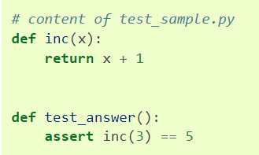
PyTest

Slide 8
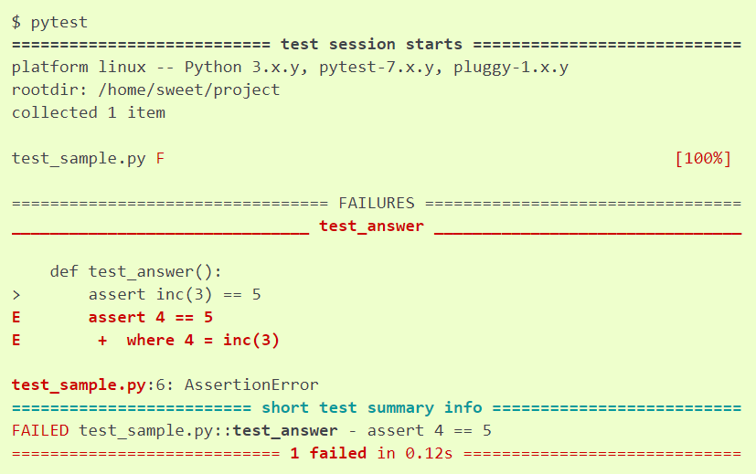
PyTest
The pytest framework makes it easy to write small, readable tests, and can scale to support complex functional testing for applications and libraries.
pytest requires: Python 3.7+ or PyPy3.
PyPI package name: pytest

Slide 9
PyTest-Script Structure
Testpaths (Folder)
module (.py file)
Pytest的class
不可使用__init__(self)
class (開頭必須為Test)
function (case，開頭必須為test_)

Slide 10
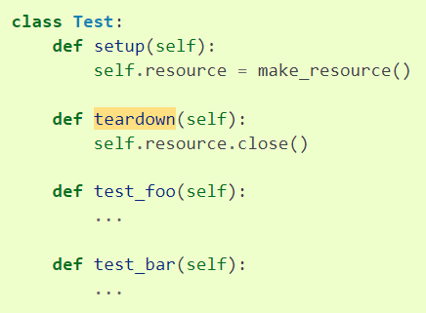
PyTest-Setup and Teardown
Testpaths
module
setup_module
class
setup_class
function
寫在class外，用setup_function
寫在class內，用setup
setup_function
setup
teardown_function
teardown
teardown_class
teardown_module

Slide 11
PyTest-Cases Hierarchy
Pytest hierarchy
ACTS3.0 hierarchy
module
Script file
class
feature
setup_class
ENV setup
function
case
function
case
function
case
function
case
class
feature

Slide 12
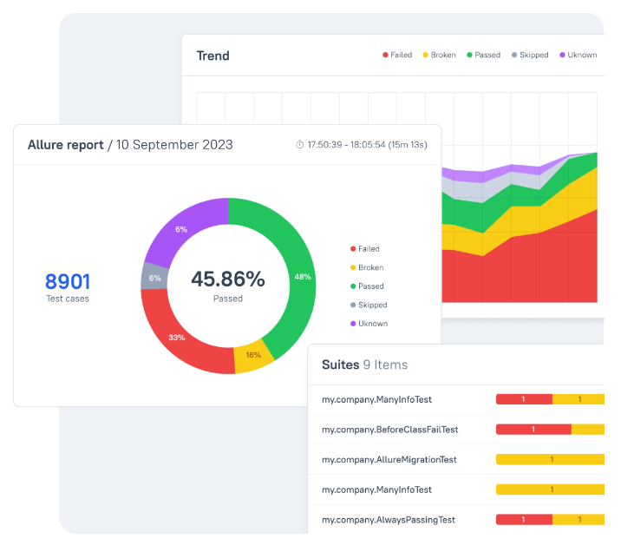
Allure Report
Allure Report is the utility that processes test results collected by a compatible test framework and produces an HTML report.

Slide 13
Allure Report-Syntax
Script
feature
@allure.feature(“Feature name”)
ENV setup
case
@allure.title(“OPAL-XX Case name”)
@allure.severity(Severity)
Severity= “BLOCKER” or ”CRITICAL” or “NORMAL” or “MINOR”
BAT
L1
L2
L3
Step
def CustomAPI ( xxx, … , lineNum=“”):
with allure.step(lineNum+”Step description”):
…
※Step寫在API的定義，script中只要直接使用API就好了
不需要寫allure.step描述
※Runner執行時會自動把lineNum傳遞給API，顯示於report上

Slide 14
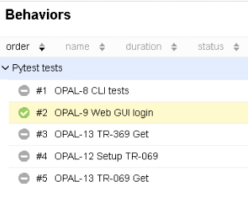

Feature Define
@allure.feature(“Feature name”)
Test開頭(首字大寫)

Slide 15
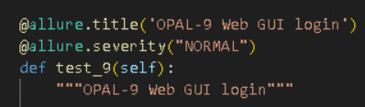
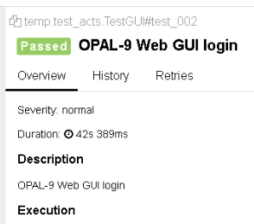
Case Define
@allure.title(“OPAL-XX Case name”)
@allure.severity(Severity)
Severity= “BLOCKER” or ”CRITICAL” or “NORMAL” or “MINOR”
BAT
L1
L2
L3
Description: case內容的描述，在def的下一行，用三個”包起來(Python的多行註解語法)
TestLink回傳機制必須從這裡取得case ID
test_開頭(首字小寫)，名稱不可重複

Slide 16
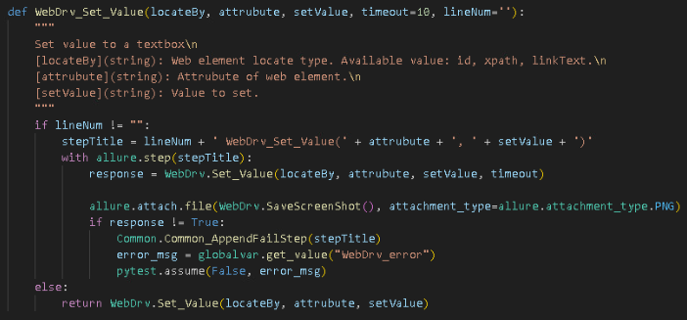
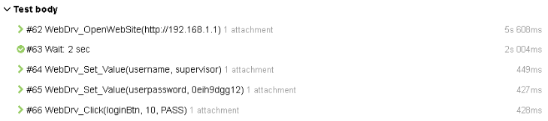
Step Define
def CustomAPI ( xxx, … , lineNum=“”):
with allure.step(lineNum+”Step description”):

Slide 17
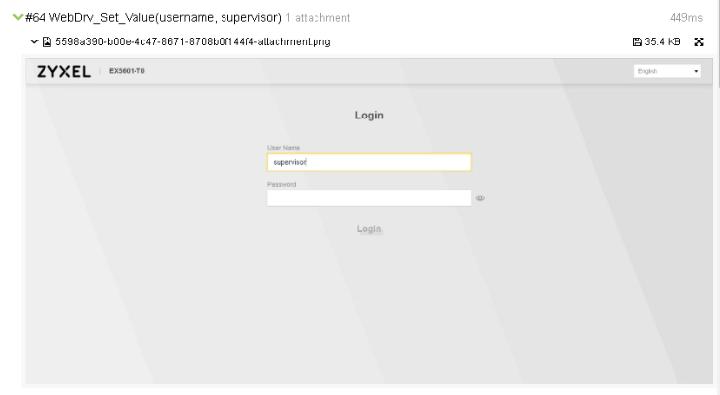
Step Attach File

Slide 18
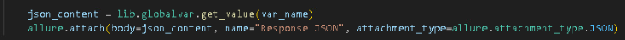
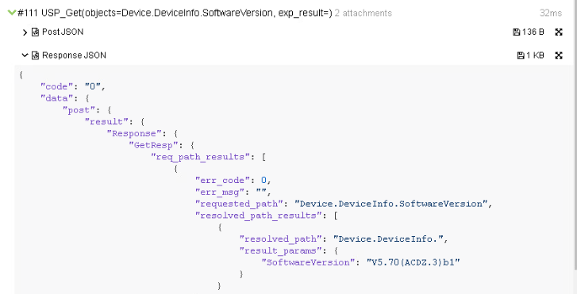
Step Attach Content

Slide 19
ACTS 3.0 Instructions

Slide 20

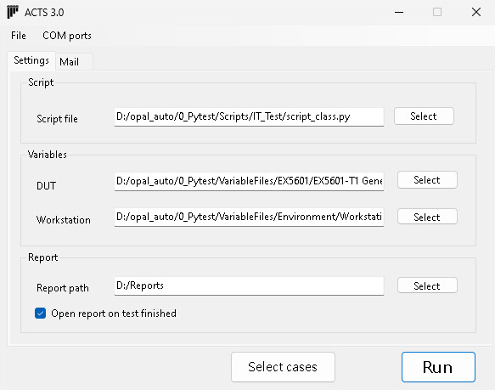
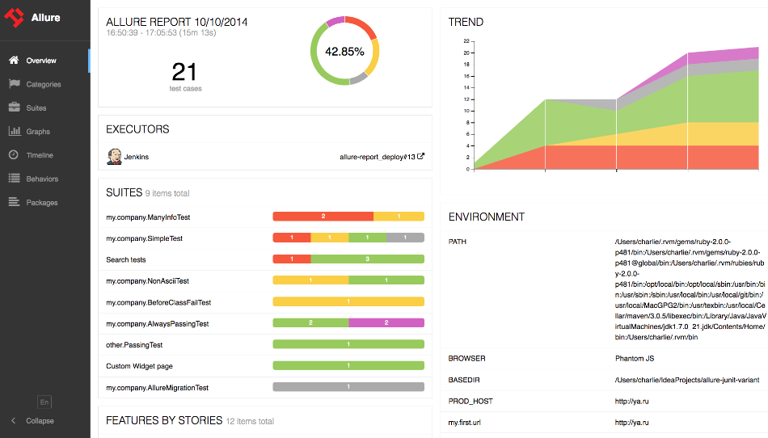

ACTS 3.0 Process Flow
Runner.py
Transfer Allure report into HTML
Upload HTML report to server
Open local Allure report
PreviousSetting.py
<Script file>
temp/test_acts.py
Insert lineNum
Insert Init functions
Import variable files(JSON)
Skip not selected cases
Pytest
Runner GUI
<Tool path>/module
D:/ACTS_3_0/module
Configure test settings
Pick test cases
Allure

Slide 21
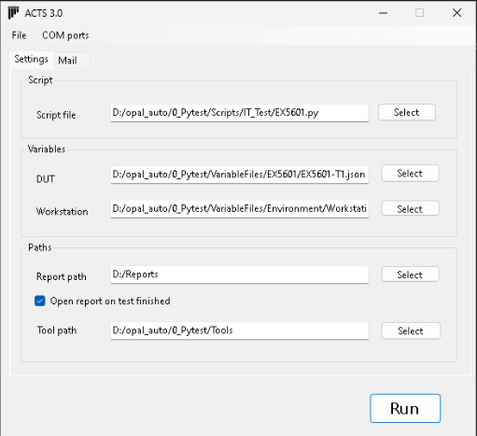
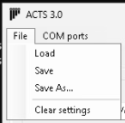
Runner GUI
Script file(.py) select
按下Run之後會自動把現在的組態存到PreviousSetting.py
也可以將組態另存為自己想要的檔案供之後載入
Variable file(.json) select
Report folder
Tool path select
Module path:
<Tool path>/module

Slide 22
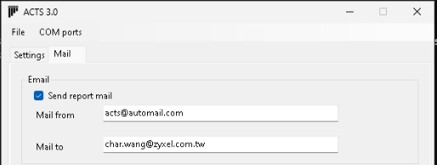
Runner GUI-Report Mail
有勾選時才會將Allure report上傳到file server，並寄出mail

Slide 23
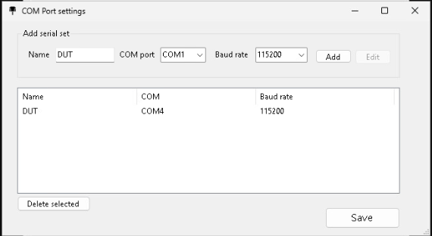
Runner GUI-COM Ports
Add /Edit COM port
COM ports list
Default name: DUT
一般的Function測試站台通常只使用一個COM port
Mesh測試站台會使用5或更多個COM ports
新的架構可自由定義COM port代號，會更容易理解COM ports的用途

Slide 24
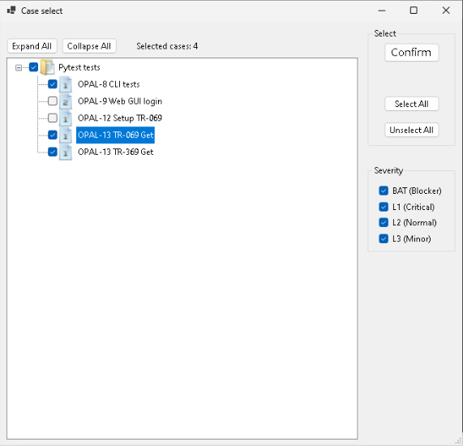
Runner GUI-Cases Select
Feature
即Pytest結構中的class
有勾選Feature時會自動執行其中的setup_class
即ENV
Severity
Cases
改變這邊勾選的項目時會直接反映在左邊的選項
即Pytest結構中的def test_xx
ACTS 3.0的case選單會直接顯示severity於icon
只要1個以上的case被選擇時上層的Feature也會自動被勾選

Slide 25
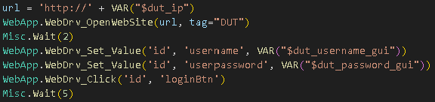
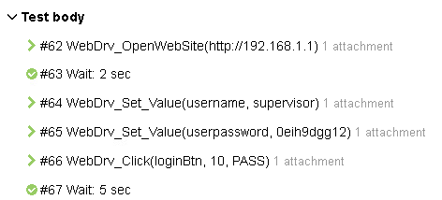
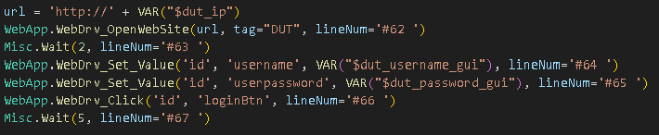
Insert lineNum

Slide 26
Copy Module Files
D:/opal_auto/0_Pytest/Tools
D:/ACTS_3_0
module
module
Insert lineNum
Copy
XXXX.py
XXXX.py
XXXX.py
XXXX.py
XXXX.py
XXXX.py
XXXX.py
XXXX.py

Slide 27
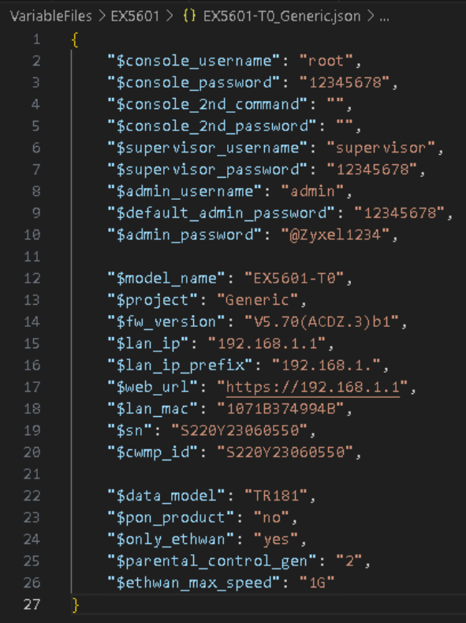
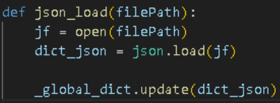
Variable Files
Variable file(JSON format)
Load JSON into dictionary(dict)

Slide 28

Variable Files
Naming rule：
$開頭、小寫、用_隔開單字
Using variable：
VAR(“Variable name”)

Slide 29
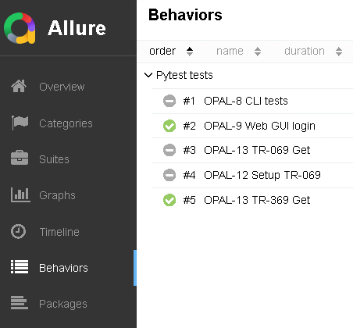
Allure Report
Order by…
Search by keyword
Show/Hide cases in specific status
Behaviors
用@allure.feature標題來展開test cases

Slide 30
Allure Report Correction
因為PyTest的原始架構是遇到fail就終止case
不符合我們使用的需求
於是使用了Pytest-assume這個套件來達成fail時繼續執行後續steps的功能
但Allure不認識Pytest-assume，於是case fail時無法將fail steps正確的顯示為fail
於是我們必須為Allure report做二次加工
改寫它產出的JSON file，將failed steps校正為fail
如果將來Allure report修正了這個bug，就可以把此功能拿掉
Case failed procedure:
Record failed step title
Use pytest.assume to set current case failed. And continue next step.
Show fail reason as attach content.

Slide 31
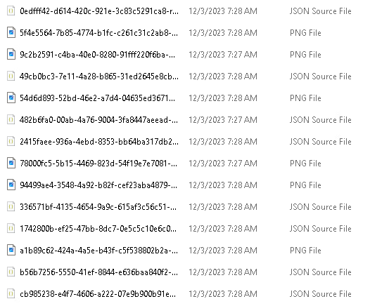
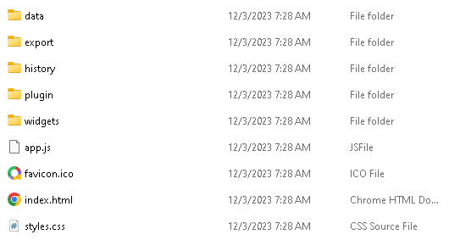
Allure HTML Report
Allure report的原始格式只有JSON與附件檔案
Runner會使用allure generate指令將它轉換成可轉發的HTML格式
但這個HTML report並不能在單機開啟
必須放在Apache、Nginx等支援JS的HTTP server上才可以開啟

Slide 32
API Reference

Slide 33
API Structure
Scripting Layer
Interface Layer
Process Layer
Call
api
Call
lib
<Script file>
Console.py
…
or
<Custom module>
Misc.py
…
TR.py
WebApp.py
只會呼叫來自Interface Layer的APIs
只處理Report流程與加掛附件，不直接寫process
只放可供script呼叫的APIs，不放多餘的東西
必須定義API說明
APIs的實際process定義在此，可定義一個或多個，結構不拘

Slide 34
Build in API Modules
Console
COM(RS-232)
Telnet
SSH
WKS control
TR
TR-069
TR-369(USP)
CPE management
WebApp
Web GUI
Smart phone APP(TBD)
Windows application(TBD)
Misc
Setup equipment
(Switch、DSLAM、OLT...)
Others

Slide 35
API Structure-In Custom Modules
Scripting Layer
Interface Layer
Process Layer
Call
<Tool path>\module
Call
<Tool path>\module
<Script file>
xxx.py
xxx
xxx.py
xxx.py
xxx.py
只會呼叫來自Interface Layer的APIs
只放可供script呼叫的APIs，不放多餘的東西
APIs的實際process定義放在下一階資料夾

Slide 36
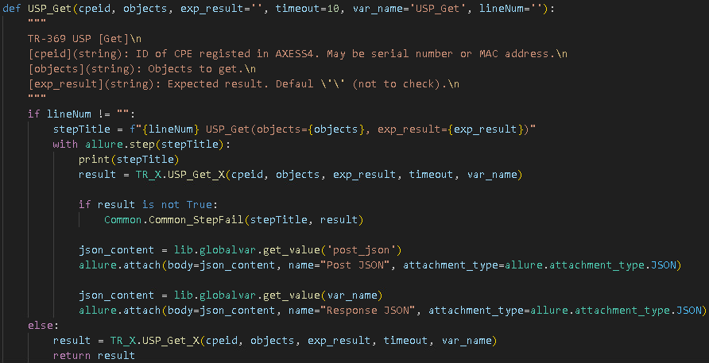
Wrap Procedure
Interface Layer
API說明
有傳入lineNum
(被script呼叫)
Case failed
為step添加附件
TR_X.py
未傳入lineNum
(被API呼叫，或是回傳值當作判斷式)

Slide 37

Call Process Function
API process function
Return True(Boolean) on execute passed
Return error message(string) on test failed
Save failed step for JSON content correction
Make this step fail and continue next step
Show fail reason as an attachment

Slide 38

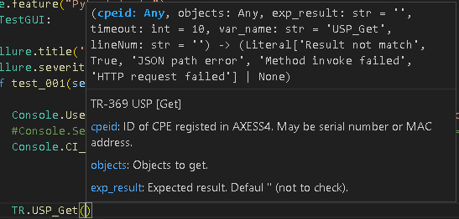
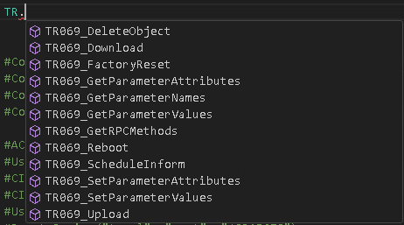
Source Code Documentation
Using Visual Studio Code
Scripting Layer
1. Import API modules
3. Input <API name>(
2. Input <module name>.
自動列出參數列表與使用說明
自動列出此module內可使用的API

Slide 39
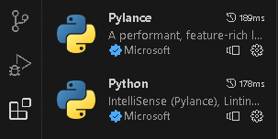

Setup Visual Studio Code
1. Import API modules
D:/opal_auto/0_Pytest/Tools
D:/ACTS_3_0
module
module
XXXX.py
XXXX.py
2. File > Preferences > Settings
Extension > Python
Set Env File as D:/ACTS_3_0/VS_Code.env
XXXX.py
XXXX.py
XXXX.py
XXXX.py
XXXX.py
XXXX.py
此檔案定義了PYTHONPATH到兩個位置
無論module放在哪一邊都可以產生關聯

